Slide 1

Summer Safety for Children with Special Need

Slide 2
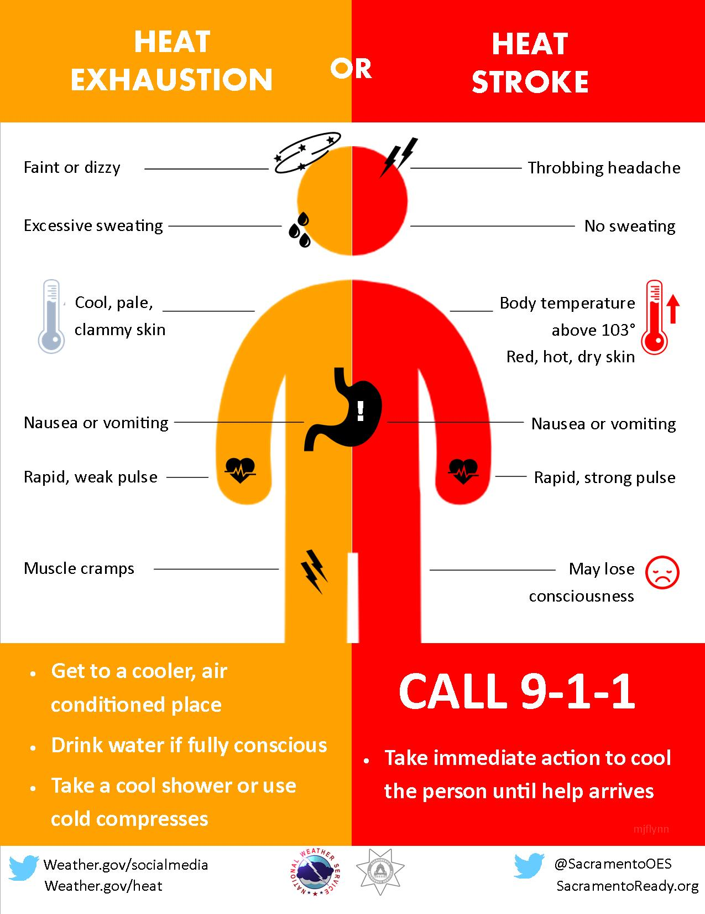
Summer Safety for Children with Special Need
During the warm summer months, it’s natural to want to get outside and take advantage of the welcoming sunshine.
However, summertime can put children with special needs at an increased risk of injury or other health complications.

Slide 3

Summer Safety for Children with Special Need
There are many reasons why children with special needs are more susceptible to serious heat-related conditions including heat stroke.
Certain medications can cause dryness in the mouth, increased sensitivity to the sun, or impair the body’s ability to regulate temperature

Slide 4

Summer Safety for Children with Special Need
In addition, some children who are neurologically impaired cannot tolerate prolonged exposure to higher temperatures without significant effect on their core body temperature.
These children should avoid outdoor activities during the heat of day.
Efforts should be made to provide air conditioning in the bedroom, school buses and classrooms to avoid serious reactions to the heat.

Slide 5
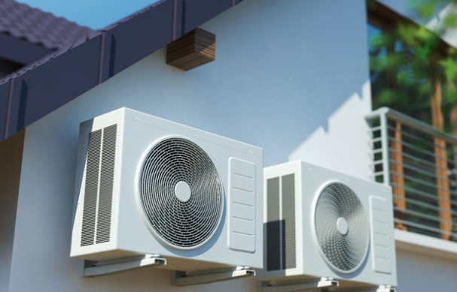
Summer Safety for Children with Special Need
The heat can also have a negative effect on children with asthma or chronic lung diseases. During the heat of day, the air quality index can be poor, making it difficult for these children to breathe.
Staying indoors in an air-conditioned environment is important to keep these children healthy.

Slide 6

Summer Safety for Children with Special Need
To avoid heat exhaustion or heat stroke:
Stay in an air-conditioned area
Drink plenty of fluids, but avoid drinks with caffeine or a lot of sugar
Drink fluids at least 30 minutes before going outside
Apply sunscreen SPF 15 or higher at least 30 minutes prior to going outside, even on cloudy days. Re-apply every two hours or after swimming or sweating

Slide 7

Summer Safety for Children with Special Need
Wear wide-brimmed hats, and light-colored, loose-fitting clothes
Eat more frequently, and be sure meals are well-balanced, cool, and light
Avoid outdoor activities from 10am to 4pm, which is the hottest part of the day

Slide 8
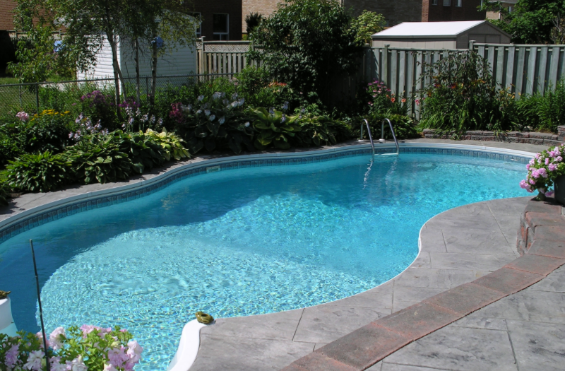
Summer Safety for Children with Special Need
Take water safety very seriously
Take all the same precautions you would for any child including:
Never leave children alone in or near the water, even for a minute.
Do not leave a child in a wheelchair parked near a pool.
Install motion detectors, alarms, or safety locks on all pools, hot tubs, or other water sources around your home.
If you have a pool, it should have a fence that has four sides, is at least four feet high, and is self-latching and secured.

Slide 9
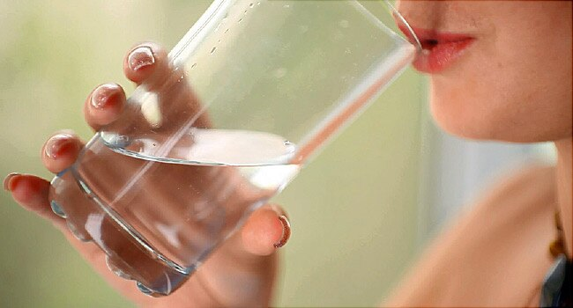
Summer Safety for Children with Special Need
If you plan on an extended outing, be sure to pack a cooler of ice and cold drinks, food, or formula.
Bring any medication or supplies you need to keep your child safe and comfortable.

Slide 10
Summer Safety for Children with Special Need Exercise: Complete the following sentences
To avoid heat exhaustion or heat stroke:
Stay in an air-conditioned area
Drink plenty of fluids, but avoid drinks with a lot of sugar
Drink fluids at least 30 minutes before going outside
Apply sunscreen SPF 15 or higher at least 30 minutes prior to going outside, even on cloudy days. Re-apply every two hours or after swimming or sweating
plenty
avoid
fluids
sunscreen

Slide 11
Summer Safety for Children with Special Need Exercise: Complete the following sentences
To avoid heat exhaustion or heat stroke:
Wear wide-brimmed hats, and light-colored, loose-fitting clothes
Eat more frequently, and be sure meals are well-balanced, cool, and light
Avoid outdoor activities from 10am to 4pm, which is the hottest part of the day
Avoid
Hottest
meals
Clothes

Slide 12


Slide 13

FUN SUMMER ACTIVITIES TO DO

Slide 14
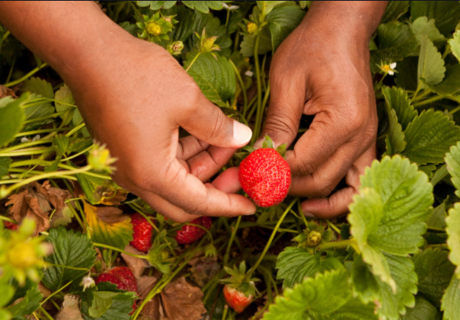
FUN SUMMER ACTIVITIES TO DO
Summer holidays can be daunting for many people. A huge change of routine coupled with trying to find suitable activities for people with special needs can, at times, be challenging.
And with summer around the corner, people with special needs such as cerebral palsy, autism and other specialist needs to prepare ahead to fill up time with entertaining events and activities.

Slide 15
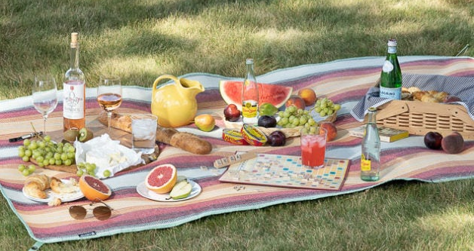
FUN SUMMER ACTIVITIES TO DO
Enjoy a picnic
Pack up your favorite lunch, grab a blanket and eat outdoors in the sunshine! If it’s raining, why not have an indoor picnic? With a picnic if you decide to go outdoors and use a blanket, an extra-large blanket will also give you plenty of room for your picnic feast and allow for additional room if you’d like a floor sitter on your blanket top surface for yourself.

Slide 16

FUN SUMMER ACTIVITIES TO DO
Simple Games
There are plenty of simple games that you can play with your child, which are fun, stimulating and good for aiding fine and gross motor skills. For example, color matching (you could use something as simple as a pair of socks), puzzles, ‘Simon Says’, encouraging rolling a ball to one another. There are also lots of great, simple games that you can download for tablets and iPads.

Slide 17

FUN SUMMER ACTIVITIES TO DO
Music Time
Music time is fantastic for people with special needs, those who are non-verbal, as it is great at helping them express themselves. You can use simple actions to songs, such as ‘the wheels on the bus's or use instruments such as homemade shakers (using a bottle and some rice) to shake to the beat. You can also have a dance!

Slide 18

FUN SUMMER ACTIVITIES TO DO
Reading Books
Reading encourages speech and language, opens a world of imagination and can bring about meaningful conversations and inspire.

Slide 19

FUN SUMMER ACTIVITIES TO DO
Outdoor Art
On warmer and dry days, being outside in the garden is the ideal opportunity for messy play – especially for those who would rather avoid risking paint or glue on the carpet! You can also buy chunky chalk, which is easy to grip, to draw on the pavements or decorate your patio.

Slide 20

FUN SUMMER ACTIVITIES TO DO
Adapted Activities
Contact local charities to find out about any adapted activities for special needs children being held during the holidays. For example, SOMA (supporting opportunities for motor activities) events, family fun days or meet-ups at local attractions. If you’re lucky, you might live by a beach which has wheelchair buggies available.

Slide 21
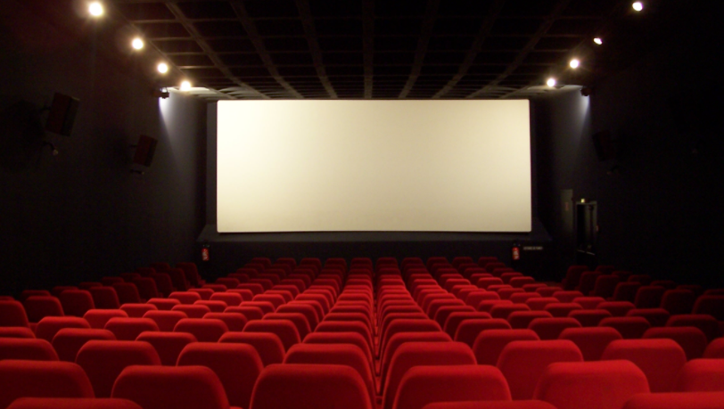
FUN SUMMER ACTIVITIES TO DO
Autism-Friendly Cinema Screenings
If you are looking for activities for people with autism, your local cinema may have ‘autism-friendly’ showings, which are more relaxed screenings of movies. These performances often meet the needs of lots of people with special needs and sensory impairments.

Slide 22
FUN SUMMER ACTIVITIES TO DO

Slide 23


Slide 24
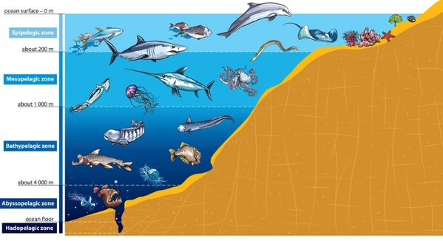
Ocean Animals

Slide 25
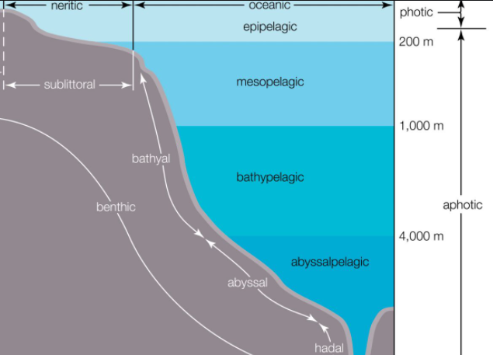
Ocean Animals
Layers of the Ocean
Scientists have divided the ocean into five main layers. These layers, known as "zones", extend from the surface to the most extreme depths where light can no longer penetrate. These deep zones are where some of the most bizarre and fascinating creatures in the sea can be found. As we dive deeper into these largely unexplored places, the temperature drops, and the pressure increases at an astounding rate. The following diagram lists each of these zones in order of depth.

Slide 26
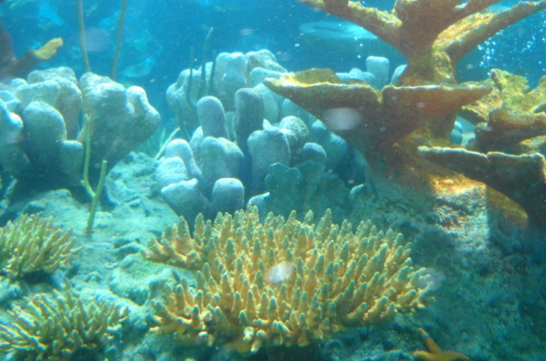
Ocean Animals
The Epipelagic Zone
Epipelagic Zone - The surface layer of the ocean is known as the epipelagic zone and extends from the surface to 200 meters (656 feet).
It is also known as the sunlight zone because this is where most of the visible light exists.
With the light come heat. This heat is responsible for the wide range of temperatures that occur in this zone.

Slide 27
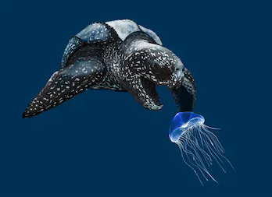
Ocean Animals
Creatures in the Epipelagic Zone
Here you will find some of the most familiar ocean animals. You will find sharks, tuna, jellyfish, and sea turtles.
You will also find blue whales, orcas, and dolphinfish. Most of the common fish that humans consume are found here in this layer.

Slide 28
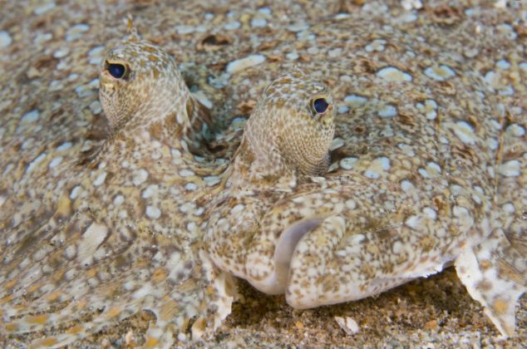
Ocean Animals
Creatures in the Epipelagic Zone
A unique quality that some of the animals in the epipelagic layer have is a type of camouflage called countershading.
This is where the animal is light on the bottom of their bodies and darker on the top.
This allows the animal to blend in with the light when a predator is below or blend in with the water when a predator is on the top of the animal.

Slide 29
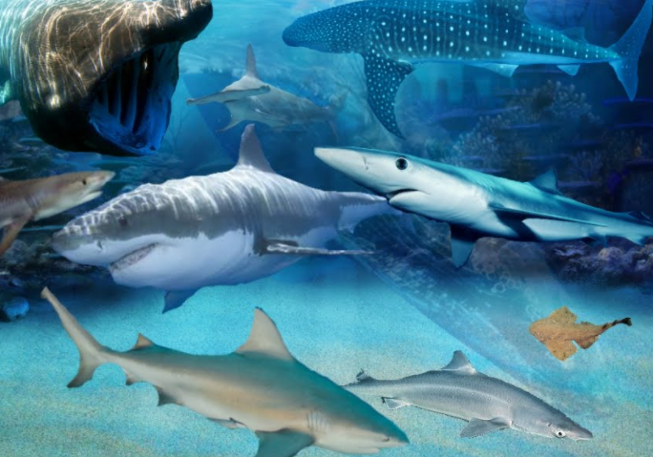
Ocean Animals
Creatures in the Epipelagic Zone
Some organisms in the Epipelagic Zone are sharks. Sharks have no bones, just cartilage.
They range from 7 inches long to 50 feet long and most sharks have streamlined bodies that can help them easily go through the water.
Bottom-dwelling sharks have flat bodies that help them hide in the sand.
Sharks can have up to 3,000 teeth at one time with 5 rows of teeth. They need all these teeth because they’re carnivores.

Slide 30
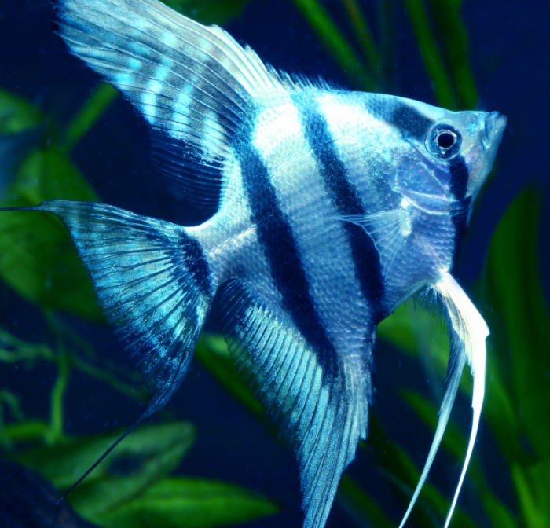
Ocean Animals
Creatures in the Epipelagic Zone
Another type of fish in the Sunlight Zone is the Angelfish.
There are about 70 different species. They are all brightly covered and live-in reefs in warm waters.
They range from 12-15 inches long. They are carnivores.

Slide 31
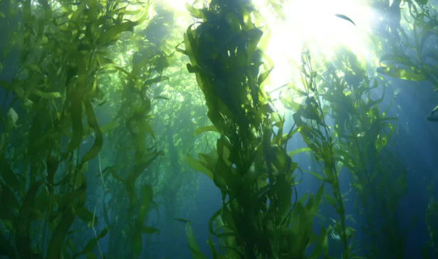
Ocean Animals
Plants in The Epipelagic Zone
Seaweed is a common plant in the epipelagic zone, along with various algae and phytoplankton.

Slide 32
Ocean Animals
Exercise: Fill in the blank
Epipelagic Zone - The surface layer of the ocean is known as the epipelagic zone and extends from the surface to 200 meters (656 feet).
Epipelagic Zone is also known as the sunlight zone because this is where most of the visible light exists.
A unique quality that some of the animals in the epipelagic layer have is a type of camouflage called countershading.
Another type of fish in the Sunlight Zone is the Angelfish.
countershading
Angelfish
Sunlight
Unique
Epipelagic

Slide 33
Ocean Animals
Exercise: Fill in the blank
Seaweed is a common plant in the epipelagic zone, along with various algae and phytoplankton
Seaweed
plant

Slide 34


Slide 35
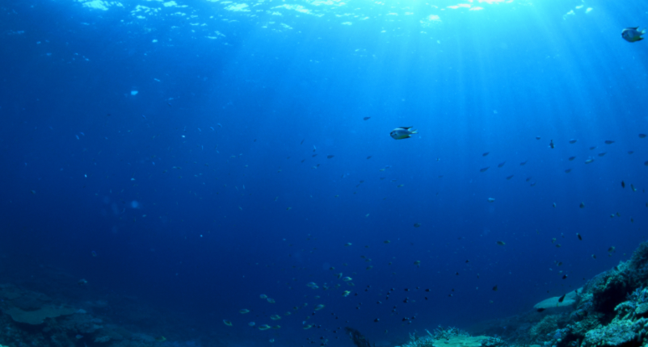
Ocean Animals
Mesopelagic Zone
Mesopelagic Zone - Below the epipelagic zone is the mesopelagic zone, extending from 200 meters (656 feet) to 1,000 meters (3,281 feet).
The mesopelagic zone is sometimes referred to as the twilight zone or the midwater zone.
The light that penetrates to this depth is extremely faint. It is in this zone that we begin to see the twinkling lights of bioluminescent creatures.
A great diversity of strange and bizarre fishes can be found here.

Slide 36
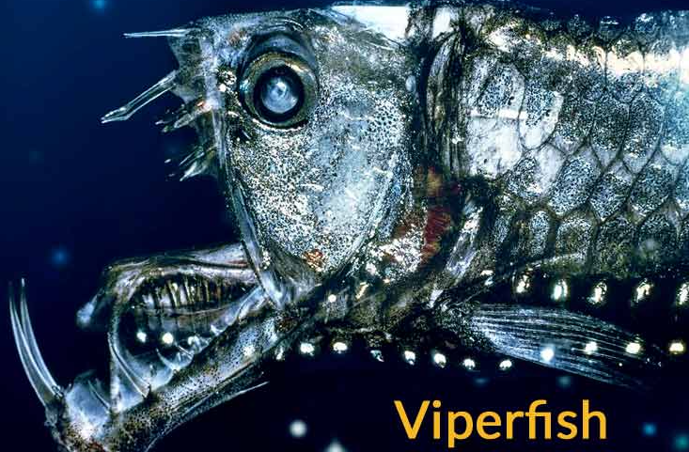
Ocean Animals
Mesopelagic Zone
One type of fish that lives in the Mesopelagic Zone is the viperfish. It has a large mouth with teeth that don’t fit in its mouth. Its mouth is hinged so they can open it as wide as they want. It uses bioluminescence. It is about 11 to 12 inches long. They are dark, silvery blue. They are eaten by sharks and some dolphins.

Slide 37
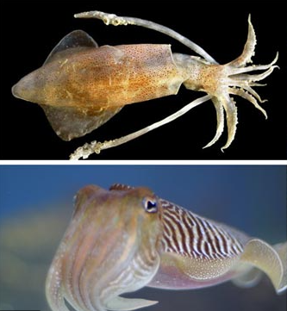
Ocean Animals
Creatures in the Mesopelagic Zone
Squid and cuttlefish are two mollusks common in the mesopelagic zone.
Cuttlefish have tentacles just like squid and are known for their abilities to change colors quickly.
Squid
Cuttlefish

Slide 38
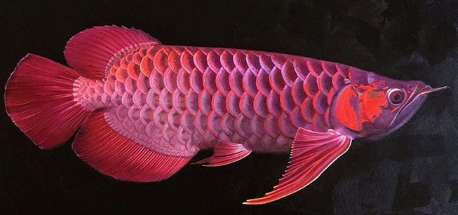
Ocean Animals
Creature in the Mesopelagic Zone
In the deeper regions of the Mesopelagic zone are various types of dragonfish. These animals have elongated bodies and large jaws, often with large, protruding eyes. One example includes the Stoplight loosejaw dragonfish, which has an elongated lower jaw and a special visual system that uses photophores to produce a small red light that it uses like a searchlight to find prey in the darkness.

Slide 39
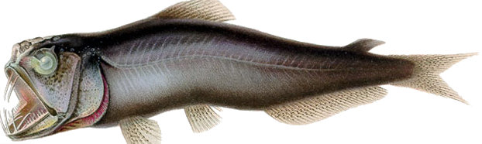
Ocean Animals
Creatures in the Mesopelagic Zone
Sabretooth fishes are appropriately named because of their oversized teeth, which they use to ambush prey in the depths of the Mesopelagic zone. They have elongated bodies like dragonfish but only reach a few inches in length. They live almost exclusively in the Mesopelagic zone, rarely venturing into shallower or deeper waters.

Slide 40
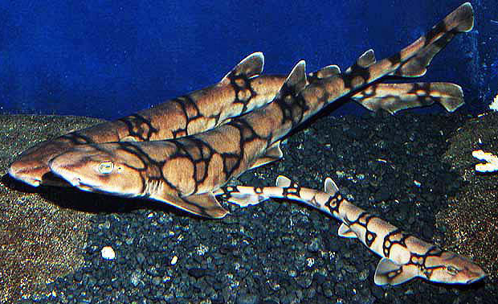
Ocean Animals
Creature in the Mesopelagic Zone
Chain catsharks inhabit the upper regions of the Mesopelagic zone. These small sharks have flat shapes as opposed to most other sharks and have skin with black and copper stripes and spots. These animals can live around 900 feet below the surface (around 300 meters) and many can be found in home saltwater aquariums.

Slide 41
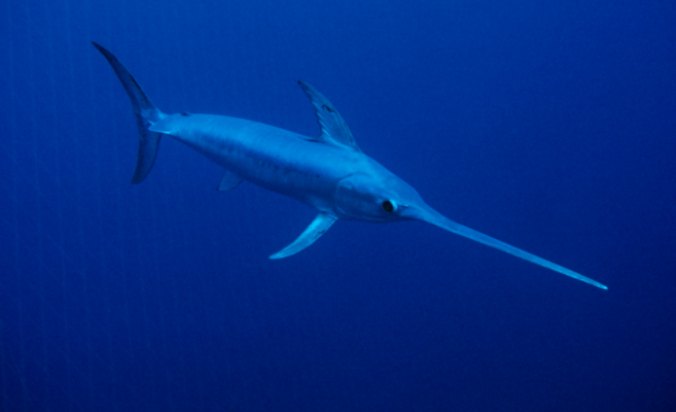
Ocean Animals
Creature in the Mesopelagic Zone
Swordfish are enormous fish, often reaching lengths upwards of 14 feet, that are known for their protruding, sword-like bills and their incredible speed, sometimes reaching up to 50 miles per hour. The swordfish, a solitary animal, spends much of its time during the day swimming about the upper regions of the Mesopelagic zone and enters shallower waters at night to feed off smaller fish.

Slide 42
Ocean Animals
Exercise: Match the name with the correct animal
Squid
Dragonfish
Swordfish
Cuttlefish
Sabretooth
Chain catshark
Viperfish

Slide 43


Slide 44
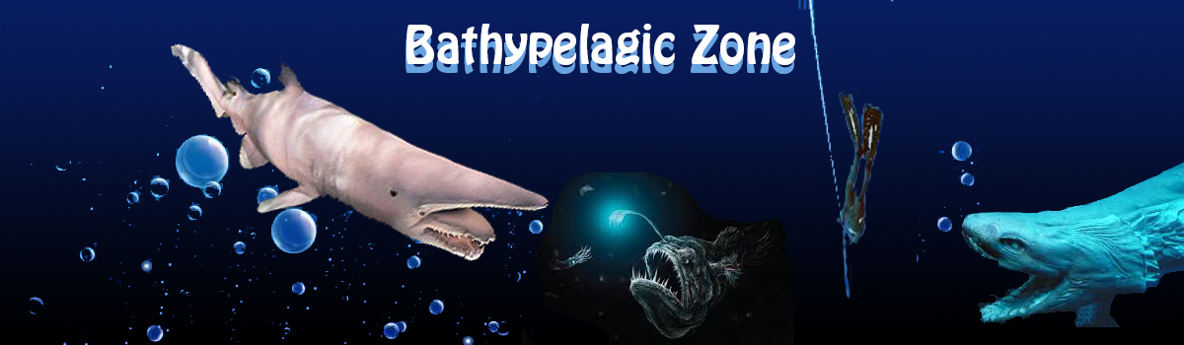
Ocean Animals
Bathypelagic Zone
Bathypelagic Zone - The next layer is called the bathypelagic zone. It is sometimes referred to as the midnight zone or the dark zone.
This zone extends from 1,000 meters (3,281 feet) down to 4,000 meters (13,124 feet). Here the only visible light is that produced by the creatures themselves. The water pressure at this depth is immense, reaching 5,850 pounds per square inch.
Despite the pressure, a surprisingly large number of creatures can be found here. Sperm whales can dive down to this level in search of food. Most of the animals that live at these depths are black or red in color due to the lack of light.

Slide 45
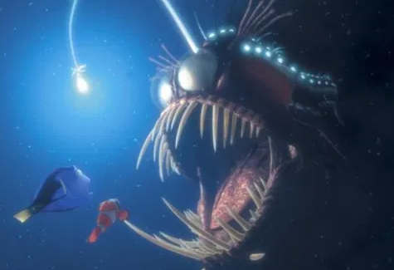
Ocean Animals
Bathypelagic Zone
Animals living in the bathypelagic zone rely on detritus for food or on eating other animals in this zone.
At this depth and pressure, the animals most found are fish, mollusks, crustaceans, and jellyfish.
Sperm whales will hunt at these depths on occasion to prey on giant squid.

Slide 46
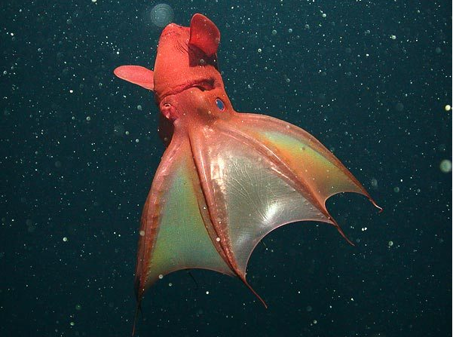
Ocean Animals
Bathypelagic Zone
Black and red are the predominant colors of animals here and any bioluminescence is usually blue since red is not visible at these depths.
The most common mollusk in the bathypelagic zone is the vampire squid, an animal that can turn itself inside-out to use its spiky tentacles to deter predators or capture prey.

Slide 47
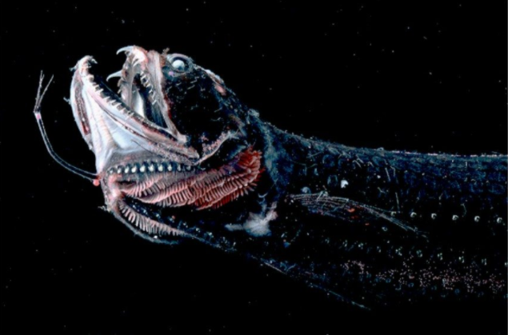
Ocean Animals
Bathypelagic Zone
The snake dragonfish resembles the viperfish or dragonfish of the mesopelagic zone and comes up to hunt at night but must travel further as it lives in deeper water than the others.
They vary in size from 1 to 20 inches in length.

Slide 48
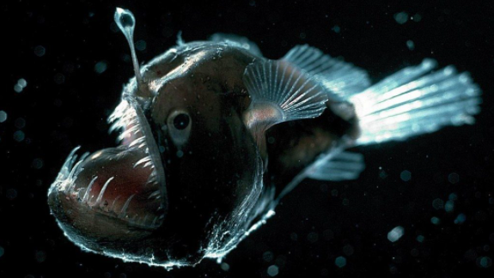
Ocean Animals
Bathypelagic Zone
The anglerfish of the bathypelagic zone is well known for its enormous mouth and a lure that resembles a flashlight on its head.
Not only does the angler fish have huge long teeth on the jaws, but it is also equipped with teeth in its throat!

Slide 49
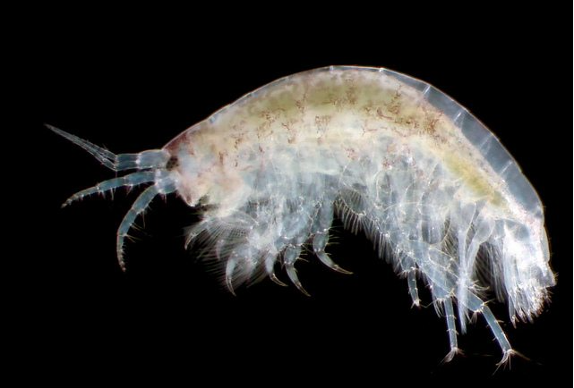
Ocean Animals
Bathypelagic Zone
Amphipods are crustaceans and scavengers in the bathypelagic zone that hide using a transparent red body.
Other crustaceans found in the bathypelagic zone include shrimp.

Slide 50
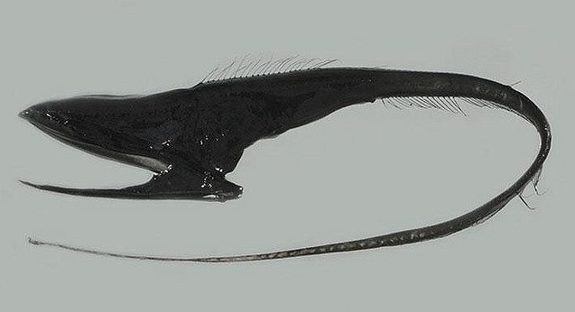
Ocean Animals
Bathypelagic Zone
The gulper eel is not a true eel, but rather a species of ray-finned fish found within the bathypelagic zone.
Sometimes referred to as a swallower or pelican eel, this extraordinary fish has no scales, ribs, pelvic fins, or swim bladders, but possesses a large, gaping mouth 11 times the volume of its entire body that can easily swallow prey much larger than itself.

Slide 51
Ocean Animals
Exercise: Name the following Animals
Angler fish
Amphipod
Gulper Eel
Snake Dragon fish
Vampire Squid

Slide 52
Ocean Animals
Exercise: Fill in the blanks
Amphipods are crustaceans and scavengers in the bathypelagic zone that hide using a transparent red body.
The anglerfish of the bathypelagic zone is well known for its enormous mouth and a lure that resembles a flashlight on its head.
Angler fish
Amphipod

Slide 53
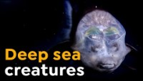

Slide 54
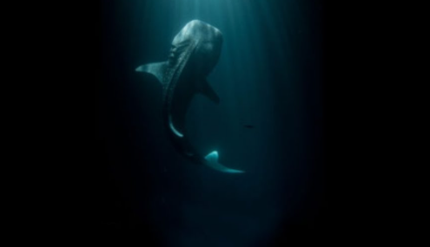
Ocean Animals
Abyssopelagic Zone
Abyssopelagic Zone - The next layer is called the abyssopelagic zone, also known as the abyssal zone or simply as the abyss. It extends from 4,000 meters (13,124 feet) to 6,000 meters (19,686 feet).
The name comes from a Greek word meaning "no bottom". The water temperature is near freezing, and there is no light at all. Very few creatures can be found at these crushing depths. Most of these are invertebrates such as basket stars and tiny squids.
Three-quarters of the ocean floor lies within this zone. The deepest fish ever discovered was found in the Puerto Rico Trench at a depth of 27,460 feet (8,372 meters).

Slide 55
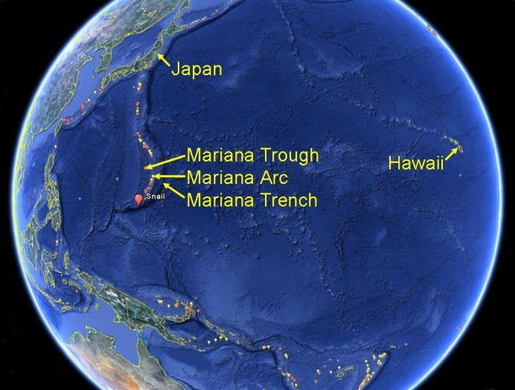
Ocean Animals
Hadalpelagic Zone
Hadalpelagic Zone - Beyond the abyssopelagic zone lies the forbidding hadalpelagic zone. This layer extends from 6,000 meters (19,686 feet) to the bottom of the deepest parts of the ocean.
These areas are mostly found in deep water trenches and canyons. The deepest point in the ocean is in the Mariana Trench off the coast of Japan at 35,797 feet (10,911 meters). The temperature of the water is just above freezing, and the pressure is an incredible eight tons per square inch.
That is approximately the weight of 48 Boeing 747 jets. Despite the pressure and temperature, life can still be found here. Invertebrates such as starfish and tube worms can thrive at these depths.
'

Slide 56
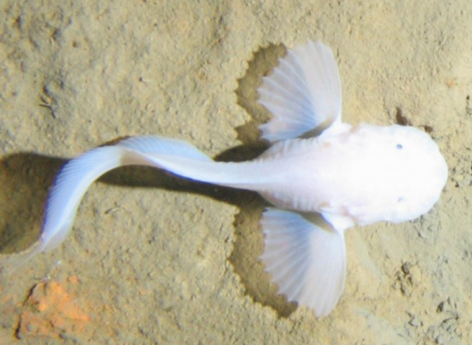
Ocean Animals
Hadalpelagic Zone
Snailfish are the most dominant family of fish found in the Hadal Zone.
These Hadal Zone animals are currently the deepest living fish ever recorded, living at a depth of 26,831 feet below the surface.
These gelatinous fish are translucent, so much so that you can see all their inner organs.

Slide 57
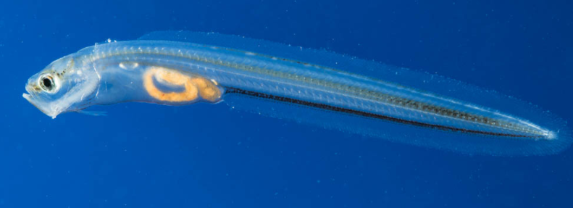
Ocean Animals
Hadalpelagic Zone
'
Cusk-Eels are eel-like fish species that have been found as deep as 27,460 feet below the surface of the ocean.
While they might look like eels and have "eel" in their name, they're not members of the eel family. Instead, they're fish that are closely related to tuna,

Slide 58
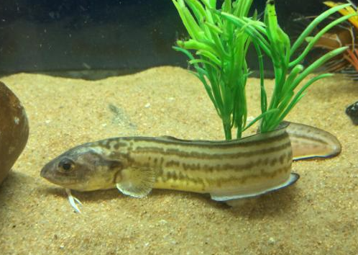
Ocean Animals
Hadalpelagic Zone
'
What's interesting about these Cusk eel is that they can be found in zones ranging from the shallow epipelagic zone all the way down to the hadalpelagic zone.
This indicates that it's able to survive in several temperatures and pressures.

Slide 59
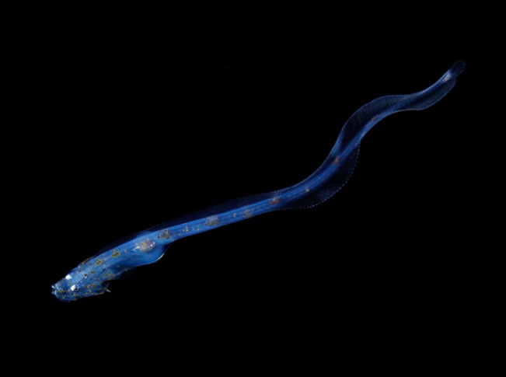
Ocean Animals
Hadalpelagic Zone
Cusk eel currently holds the record for the deepest known fish.
It's believed to mostly eat amphipods and plankton.
Like snailfish, the specimen captured has translucent skin.
'

Slide 60
Ocean Animals
Exercise: Fill in the blank
'
Snailfish are the most dominant family of fish found in the Hadal Zone.
Cusk eel currently holds the record for the deepest known fish.
These Hadal Zone animals are currently the deepest living fish ever recorded, living at a depth of 26,831 feet below the surface.
Like snailfish, the specimen captured has translucent skin.
Snailfish
Cusk Eel
26,831
translucent
2,600

Slide 61
Ocean Animals
Exercise: Match the right animal
Cusk Eel
Snailfish

Slide 62
